Slide 1
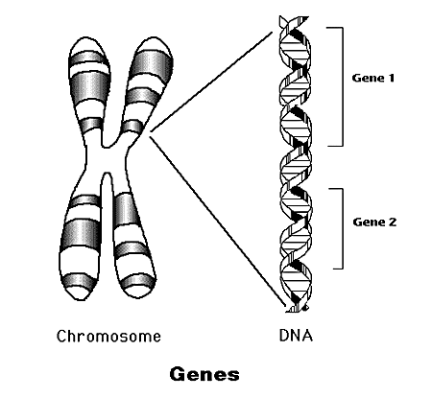
Genes

Slide 2
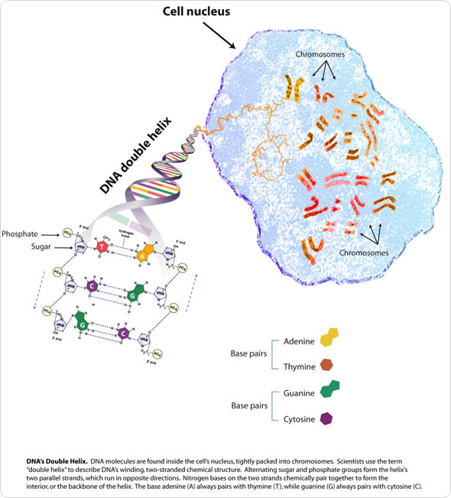
What is a gene?
A gene is a working subunit of the DNA molecule that contains information on protein production.
There are over 50,000-100,000 genes in the entire human genome, made up of millions of bases.
Despite their large numbers, the DNA in the genes represent only 2% of the total genome.

Slide 3

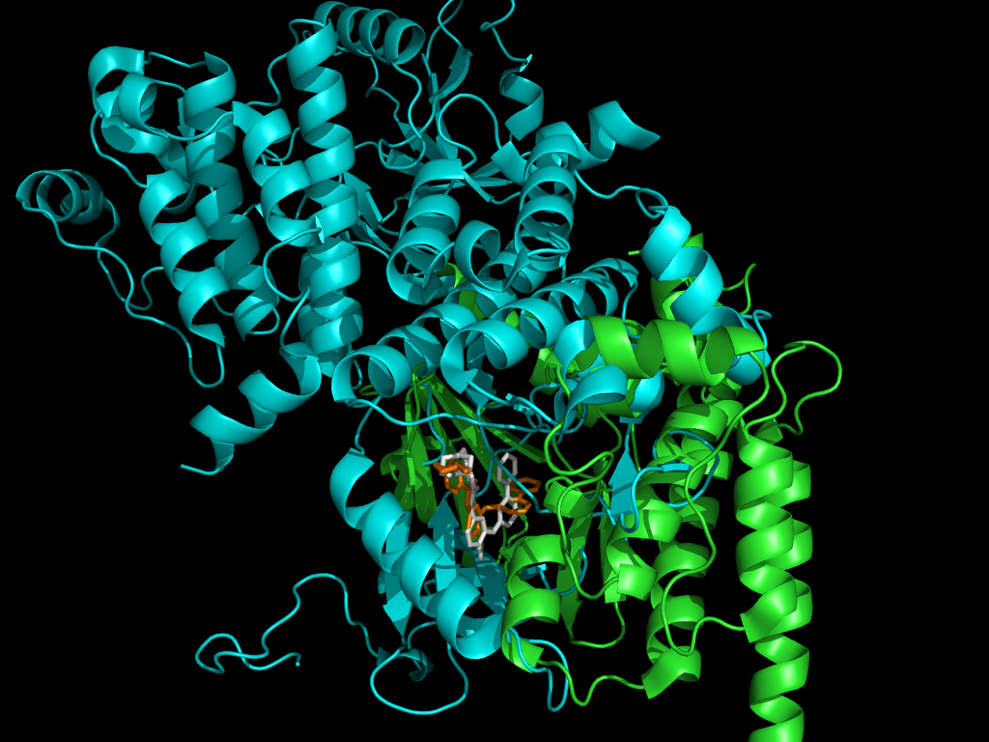
Coding DNA Genes
These genes contain genetic code that is used to make amino acids and proteins.
The promoter identifies where the gene starts so it can be transcribed.
The terminator is used to help mark the end of a gene.
Promoters and terminators are basically the on/off switches that tell when to transcribe and when to stop.

Slide 4
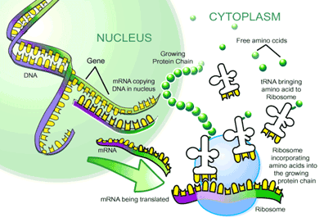
How do we get a proteins from a gene?
Finally, the amino acids are carried by tRNA to be added to a growing protein chain, until the translation of the mRNA is complete.
mRNA, or messenger RNA, helps to transcribe the DNA sequences where the gene is located.
The mRNA is sent to the ribosome, where it is decoded and amino acids are made based upon the sequences.

Slide 5
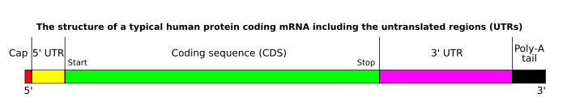
Untranslated Regions (UTR)
The five prime UTR influences the translation rate of mRNA through its length.
The three prime UTR is usually found after the stop codon, which signals when to stop translation.
The five prime UTR is usually before the start codon.
The three prime UTR influences the rate at which the mRNA decays, meaning that protein concentration can be altered through modification of the three prime UTR.

Slide 6
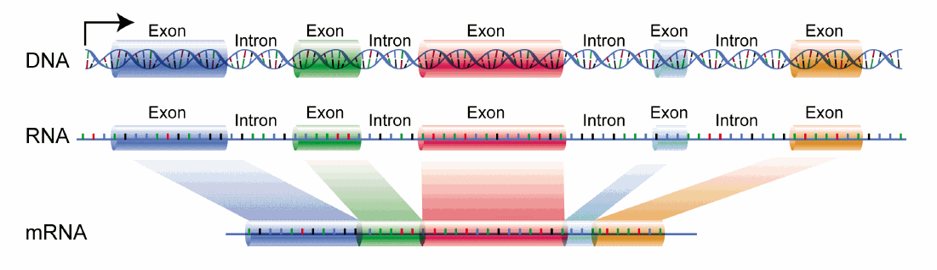
Exons and Introns
An exon, in its simplest form, is an area where the DNA is translated.
An intron, simply put, is junk DNA (during translation), that is cut out during translation.
RNA splicing is the term given when the mRNA introns are removed and the exons are all linked together.
A process called RNA processing helps to remove the introns that were removed and helps to splice the exons together.

Slide 7
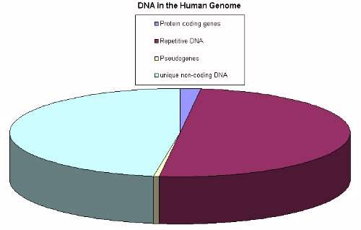
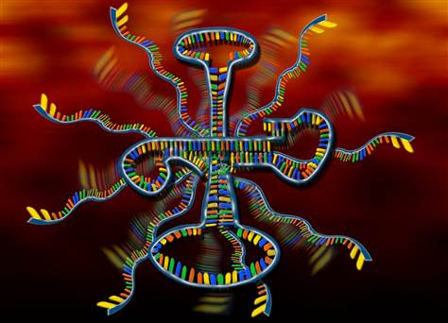
Non-Coding DNA Genes
Non-coding DNA is DNA that does not encode for a specific protein.
Out of a total of 3.2 GB in the human genome, only 1.2 GB is Coding DNA.
Many people classify the DNA of these genes to be junk, because they do not code proteins.
Even though these genes don’t make proteins, they make important RNA molecules.

Slide 8
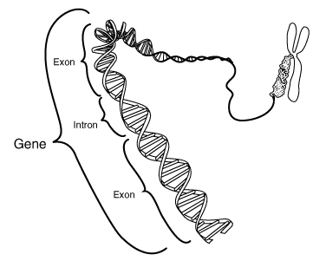
Exomes and Intromes
The exome consists of all the exons/coding DNA in the exons.
The introme consists of all of the non-coding DNA inside the intromes.
Non-coding and coding DNA can be found in Coding DNA genes, but only non-coding DNA genes can only contain non-coding DNA.
Overall, the exomes and intromes compose about 30% of the entire human genome, while the rest is entirely made of non-coding DNA genes and “junk”.

Slide 9
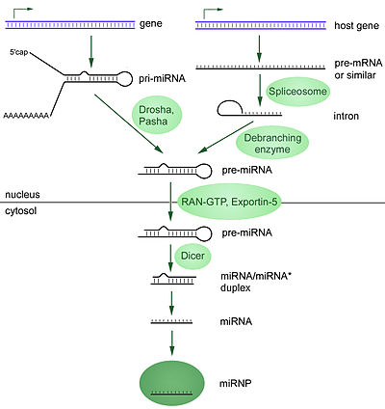
MicroRNA
MicroRNA (miRNA), is a newly discovered part of the human genome, that helps to regulate gene expression.
They are fairly short at 22 nucleotides per strand.
They are used by the body to regulate the cell cycle, silencing a gene by binding to the 3’ UTR, they help in immune responses, and also play a part in aging.

Slide 10
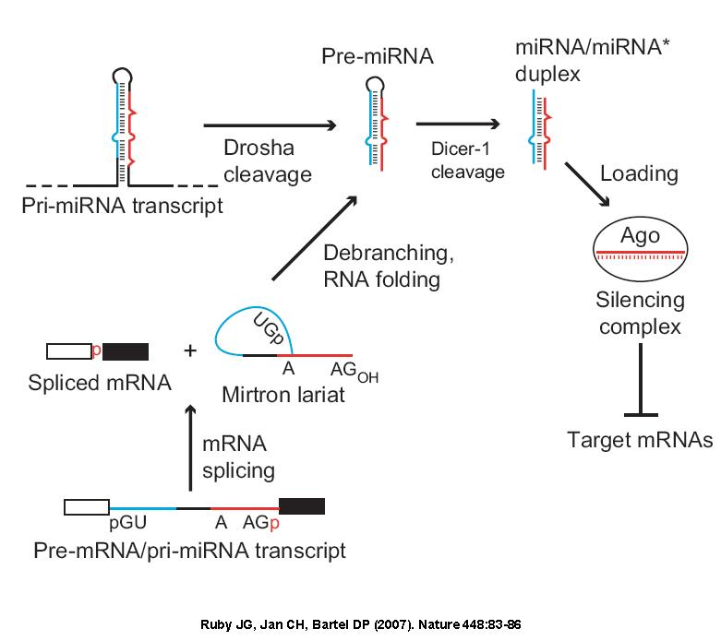
mirTRON
mirTRONS are a type of miRNA that are found in the introns of protein coding genes.
Even though they are located somewhere else, they still do their intended job of regulating gene expression.

Slide 11
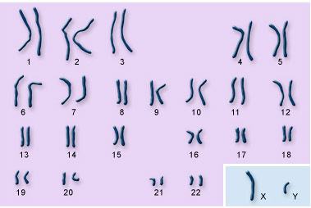
Human Genes
Total Number of Human Genes: around 20,000-25,000 protein coding genes, lower than the previous estimate of 35,000, with about 500 non-coding genes.
Although the Human Genome Project is complete, the exact number of genes in the genome is unknown.

Slide 12
Question #1
1) Which of the following does the 5’ UTR regulate?
A) Gene expression
B) Heart rate
C) Genetic damage
D) Gene production

Slide 13
Question #1
1) Which of the following does the 5’ UTR regulate?
A) Gene expression
B) Heart rate
C) Genetic damage
D) Gene production

Slide 14
Question #2:
2) Which of the following is miRNA NOT used for?
A) Gene silencing
B) Disease marking
C) mRNA degradation
D) Chromosome production

Slide 15
Question #2:
2) Which of the following is miRNA NOT used for?
A) Gene silencing
B) Disease marking
C) mRNA degradation
D) Chromosome production

Slide 16
References
http://hydra.icgeb.trieste.it/~pongor/biophys-homepage/Protein_evolution/LPPROTEIN1-ch1.pdf
http://compbio.cs.toronto.edu/ligalign/images/1xbb_proteins.png
http://www.accessexcellence.org/RC/VL/GG/images/genes.gif
http://www.news-medical.net/health/Genes-What-are-Genes.aspx
http://psych.colorado.edu/~carey/hgss/hgsschapters/HGSS_Chapter03.pdf
http://ebbailey.files.wordpress.com/2011/03/biotrans.gif
http://upload.wikimedia.org/wikipedia/commons/1/12/DNA_exons_introns.gif
http://www.pandasthumb.org/archives/images/GENOME.jpg
http://www.daviddarling.info/images/exon_and_intron.gif
http://www.edinformatics.com/math_science/human_chromosomes2.jpg

